Slide 1
DV1C04 Continuous Monitoring in DevOps
L12
Nagios Installation and Configuration

Slide 2
Lessons Overview
Lesson 11: Intro to Continuous Monitoring and Nagios. Download and prep lab. Configure SSH (secure remote execution).
Lesson 12: Install and configure Nagios. Implement local and remote monitoring of servers in a network.
Lesson 13: Configure and implement Nagios monitoring (nagios.cfg, timeperiods, commands, hosts, services, dependencies)
Lesson 14: Automate and customize visualization dashboard. Learn and implement security monitoring.

Slide 3
Learning Objectives – L12
Describe overview of Continuous Monitoring.
Relate to DevOps Monitor phase.
Describe the mechanics of Nagios monitoring tool.
Utilize Nagios monitoring tool to monitor local and remote server applications and services.
Utilize encrypted channels for remote monitoring across enterprise networks.

Slide 4
Today’s Lesson Flow
Brief on Nagios installation and infrastructure
Lab on Nagios installation and configuration.
Break
Lab: Set up and configure client containers
Lab: Implement SSH secure network communications using private-public keys
Lab on Nagios local and remote monitoring
Debrief

Slide 5
Nagios Plugins
The Nagios package in Ubuntu comes with a number of pre-installed plugins:
apt.cfg breeze.cfg dhcp.cfg disk-smb.cfg disk.cfg dns.cfg
dummy.cfg flexlm.cfg fping.cfg ftp.cfg games.cfg hppjd.cfg
http.cfg ifstatus.cfg ldap.cfg load.cfg mail.cfg mrtg.cfg mysql.cfg
netware.cfg news.cfg nt.cfg ntp.cfg pgsql.cfg ping.cfg
procs.cfg radius.cfg real.cfg rpc-nfs.cfg snmp.cfg ssh.cfg
tcp_udp.cfg telnet.cfg users.cfg vsz.cfg
There are many more available… Just google “nagios plugins”

Slide 6
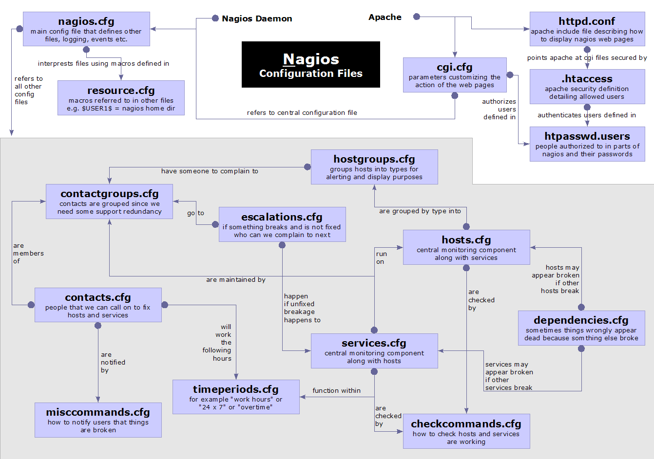
Nagios Configuration

Slide 7
Lab Time

Slide 8
Nagios Configuration Files
Located in /etc/nagios/
Important files:
cgi.cfg - controls the Web Interface options security
commands.cfg - commands that Nagios uses to notify
nagios.cfg - main Nagios configuration file
conf.d/* - the core of the config files

Slide 9
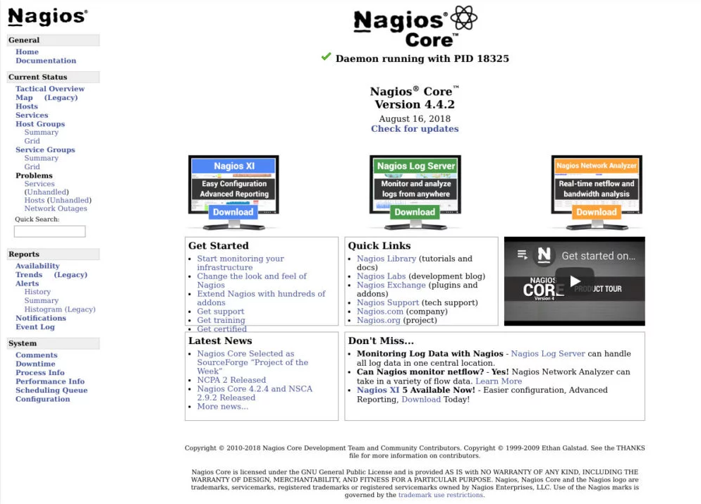
Nagios GUI

Slide 10
Debrief

Slide 11
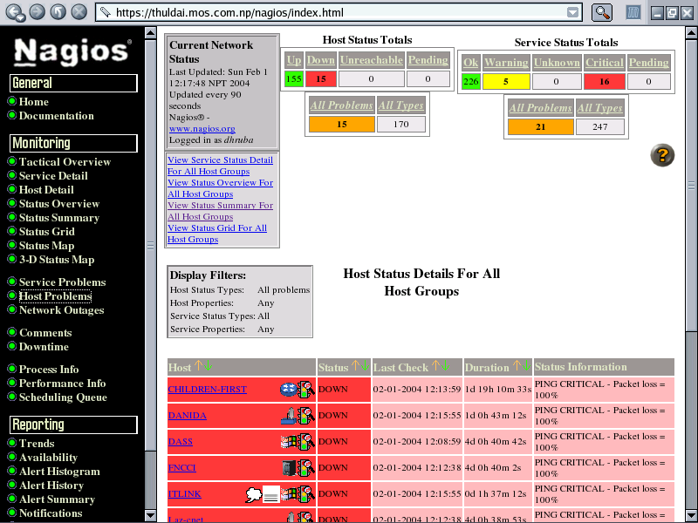
Nagios Status Detail screen

Slide 12
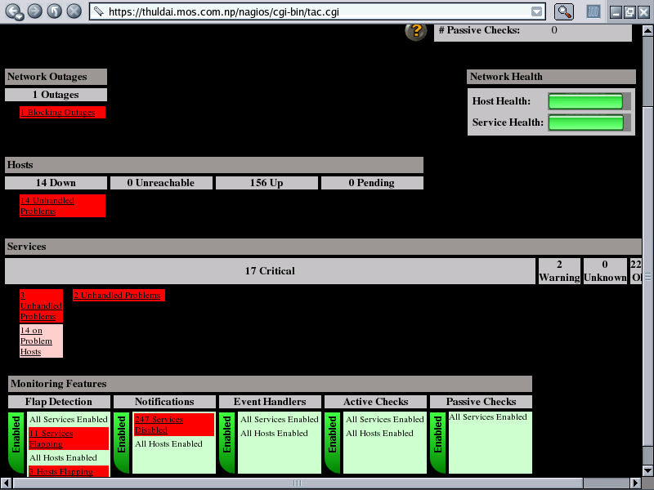
Tactical Overview Of Nagios

Slide 13
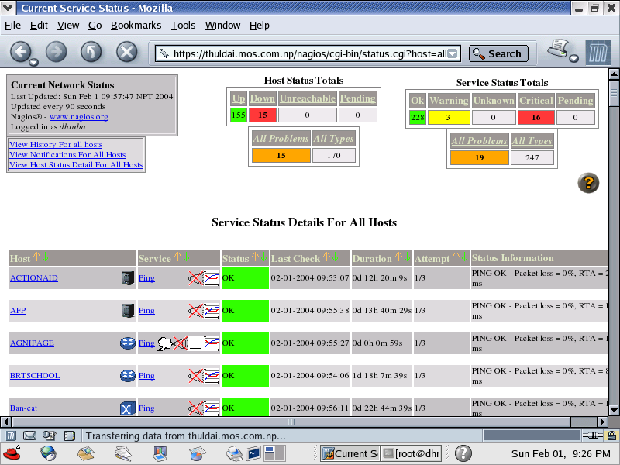
Service Detail of Nagios

Slide 14
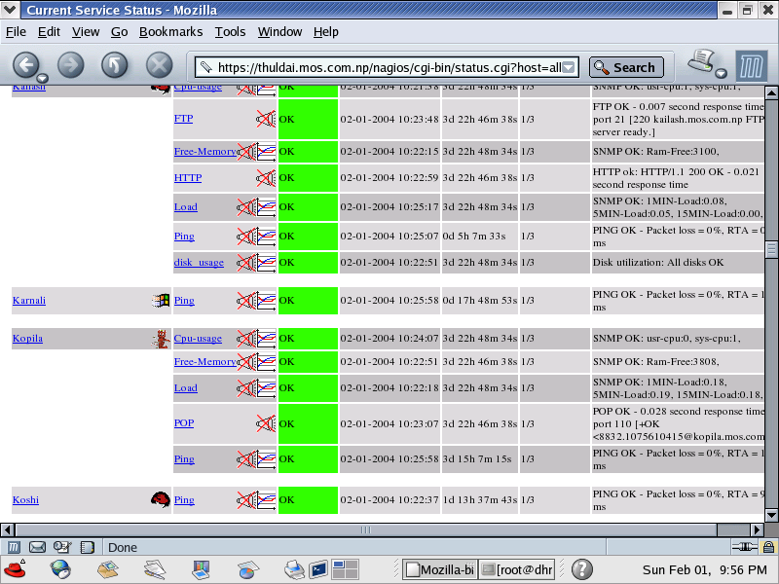
Service Types

Slide 15
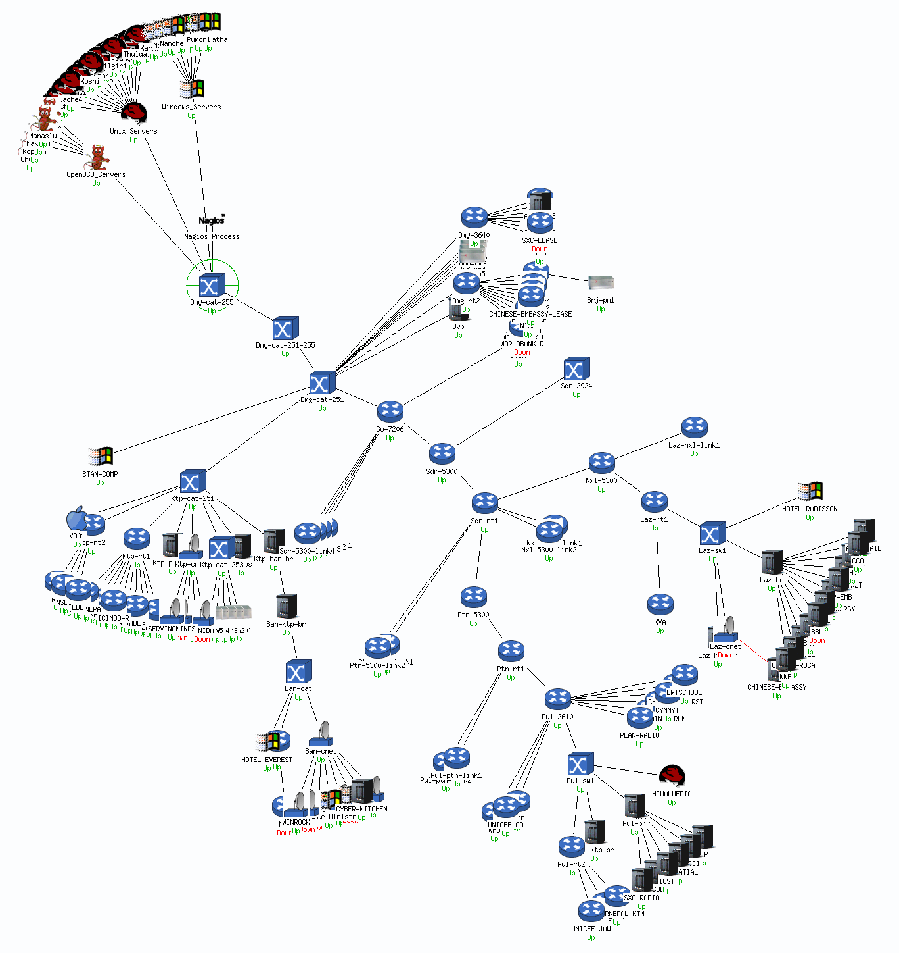
Status Map of MC Network From Nagios

Slide 16
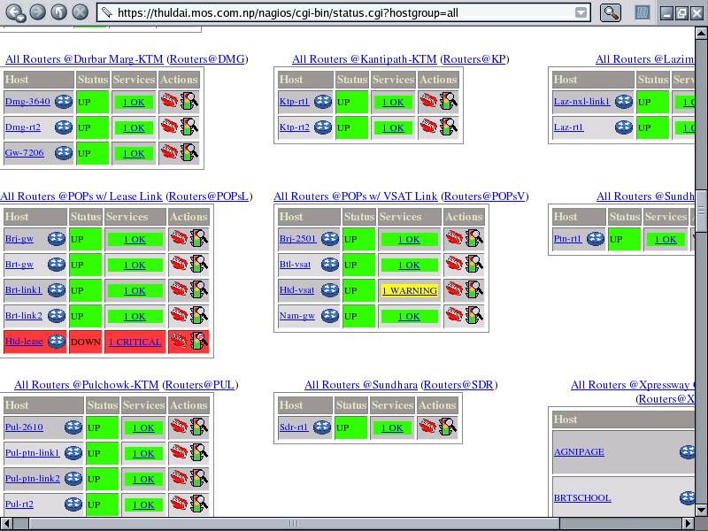
Status Overview from Nagios

Slide 17
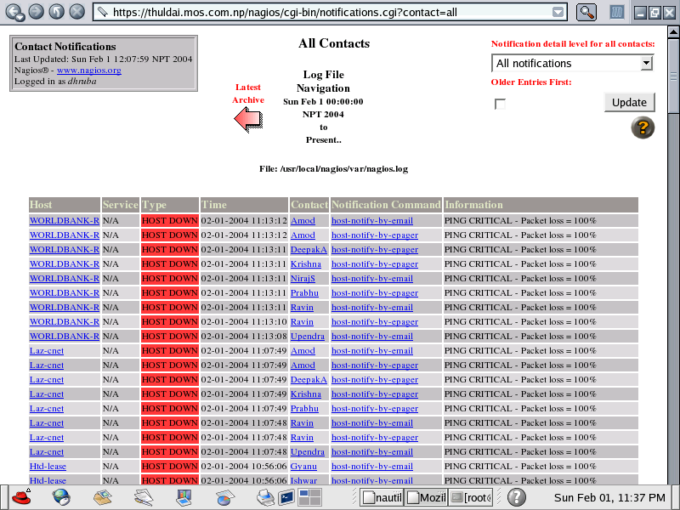
Who is Notified?

Slide 18
Notification Email Sample
From: nagios@thuldai.mos.com.np
To: "ishwars@mos.com.np" <ishwars@mos.com.np>
Subject: Host DOWN alert for WORLDBANK-L!
Date: 05/02/04 11:09
***** Nagios *****
Notification Type: PROBLEM
Host: WORLDBANK-L
State: DOWN
Address: 202.52.239.70
Info: PING CRITICAL - Packet loss = 100%
Date/Time: Thu Feb 5 11:06:38 NPT 2004

Slide 19
Nagios Resources
Nagios Home http://www.nagios.org/
Nagios Plugins and Add-Ons Exchange http://www.nagiosexchange.com/
Nagios Tutorial for Debian http://www.debianhelp.co.uk/nagios.htm
Nagios Commercial Support http://www.nagios.com/
Nagios Videos https://www.youtube.com/channel/UCiv97WODwd6sgIgmsy3vqaA
How to Monitor SNMP (Series) https://www.youtube.com/watch?v=oT0tPsrEQgQ&list=PLN-ryIrpC_mAFLgaaA61U0tjH0qV1HP57&index=1
How SNMP Traps Work in Nagios XI network monitor https://www.youtube.com/watch?v=RRhp8tQcJyU

Slide 20
Thank you

